Slide 1

Email Classification Into Abusive And Non Abusive
Project
Based On
Natural Language
Processing (NLP)
Technique
Team Members
1. Sanket Bait
2. Satyaprakash Chhabile
3. Anil Jadhav
4. Mohammad Ali
5. Kakaraparthi Mahesh

Slide 2
Business Problem:
Inappropriate emails would demotivates and spoil the positive environment that would lead to more attrition rate and low productivity and Inappropriate emails could be on form of bullying, racism, sexual favouritism and hate in the gender or culture, in today’s world so dominated by email no organization is immune to these hate emails.
Objective :
The goal of the project is to identify such emails in the given day based on the above inappropriate content.
Methodologies:
Naive Buyes
Support Vector Machine (SVM)
Extra Tree Classifier

Slide 3
NLP Definition :
The Term Natural Language Processing encompasses a broad set of Technique for automated generation, manipulation, and analysis of natural or human language.
S0, NLP comprises Of mainly three things -:
Automated Generation of Natural Language.
Text manipulation of Natural Language.
General analysis of Natural Language.
Although most NLP technique inherit largely from Linguistics and Artificial Intelligence, They are also influenced by relatively newer areas such as Machine Learning, Computational Statistics and Cognitive Sciences.

Slide 4
PROJECT WORK FLOW
Start
Fetch Data
EDA
Clean Data
Data Preprocessing
Stationarity
Data Spliting
Training Data
Test Data
Feature Selection
Train Model
Predict Data
Performance Measure
Deployment Model

Slide 5
Exploratory Data Analysis (EDA)
Labels:
Number of messages ID columns has more than 10000 unique items or labels.
Filename columns has more than 10000 unique items or labels.
Content Columns has more than 10000 unique items or labels.
Class Column has 239 unique items or labels.
Data set Information : Feature Of Interest:
No. of Columns: 05 1. Independent Variable, X= Content
No. of Records: 48076 2. Dependent Variable, y = class

Slide 6
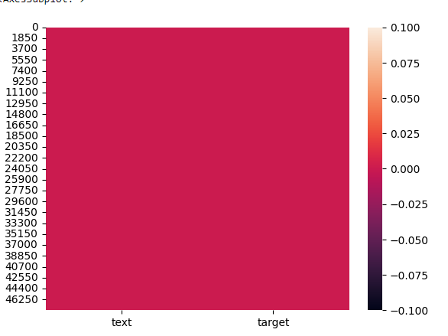
Checking the Missing Values Visualizing Missing Values
[ ] df.isnull.sum()
[ ] sns.heatmap(df.isnull())
- There is no missing values in the dataset.
Check Duplicated records in the dataset.
- [ ] df.duplicated().sum()
- There are 147 duplicate values present in the dataset
- We Remove the duplicated records using

Slide 7
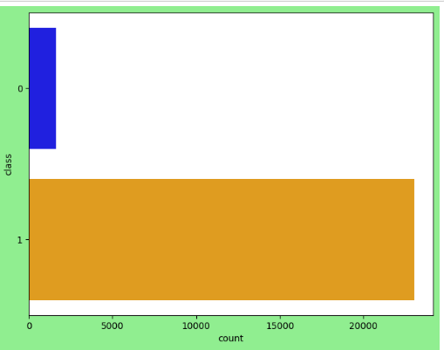
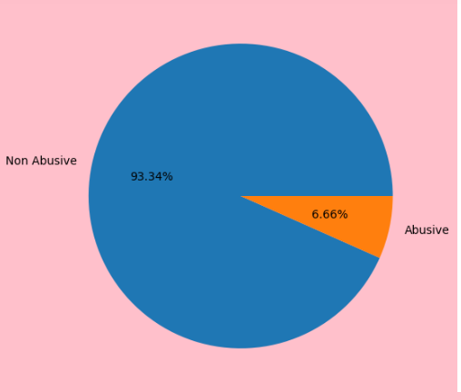
Count Plot For Abusive And Non Abusive Mails:
The Dataset is Highly with 1642 Abusive Mails, 23014 Non Abusive Mails and Some Missing data.
The dataset is Indicating a highly imbalanced dataset

Slide 8
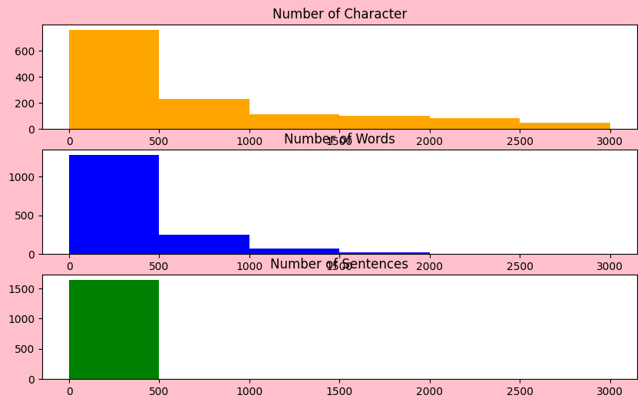
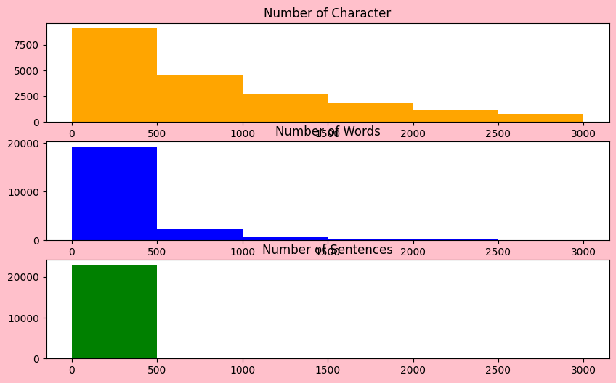
Visualizing how many character, sentences and word include in Non Abusive and Abusive Emails Using Histogram
Abusive Mails
Non Abusive Mails

Slide 9
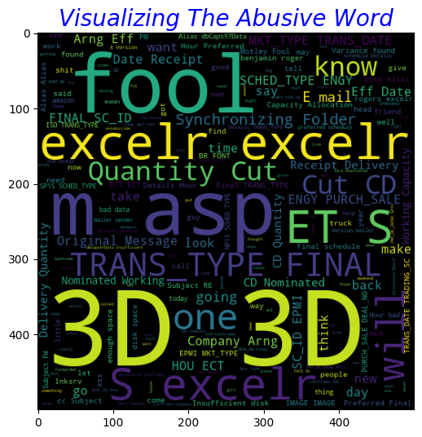
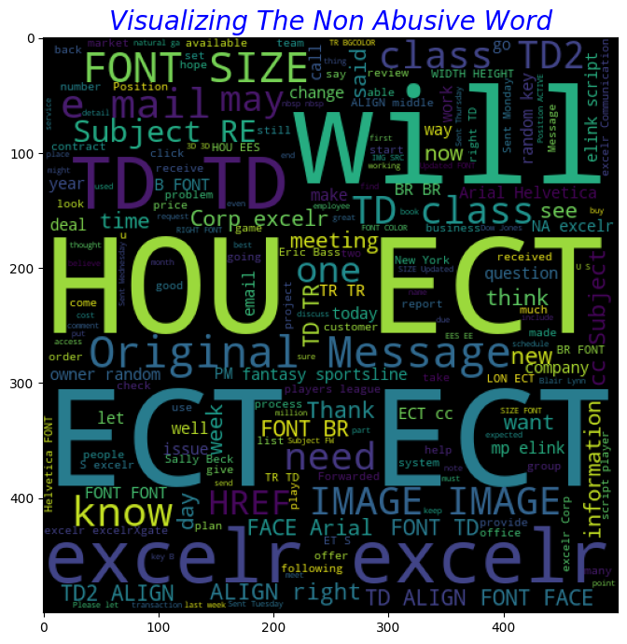
Visualize the Abusive And Non Abusive Email Using Words Cloud Before Preprocessing
Abusive Mails
Non Abusive Mails

Slide 10
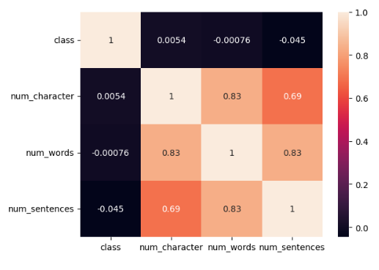

Correlation Analysis

Slide 11
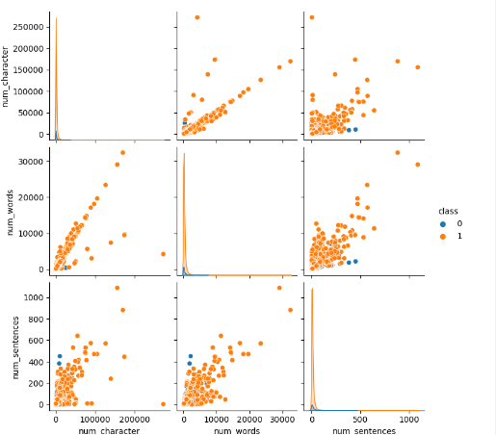

Visualizing Correlation using pair plot

Slide 12
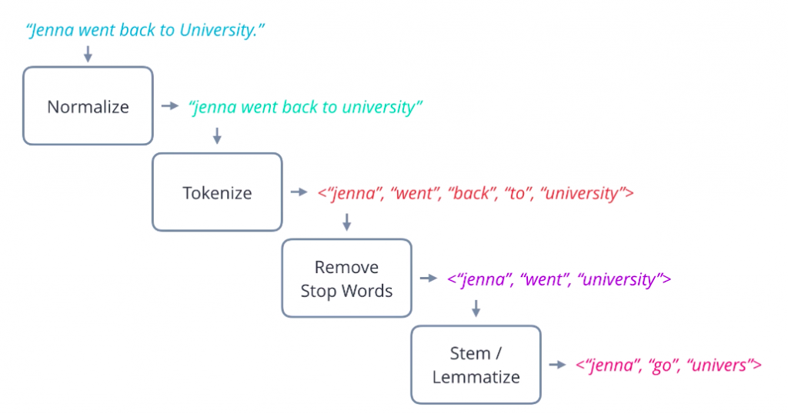
Data Cleaning And Preprocessing
Removing the numbers, symbols, punctuations, spaces, special characters from the text data.
Normalizing the data by lowering the case of the text.
Tokenizing the data from each sentences of the emails.
Lemmatizing the words.
Removing the stop words from the text data.
Rejoin meaningful stem words in single string like a sentence.
Finally vectorizing all the word into vector matrixes

Slide 13
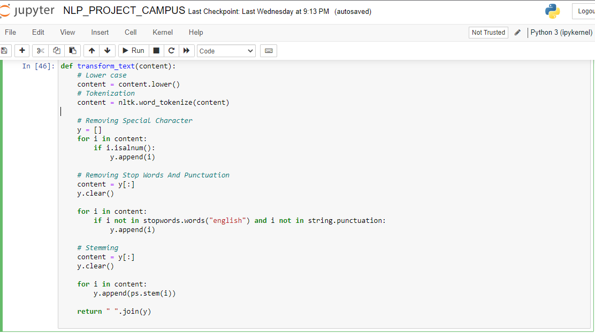
Code -:

Slide 14
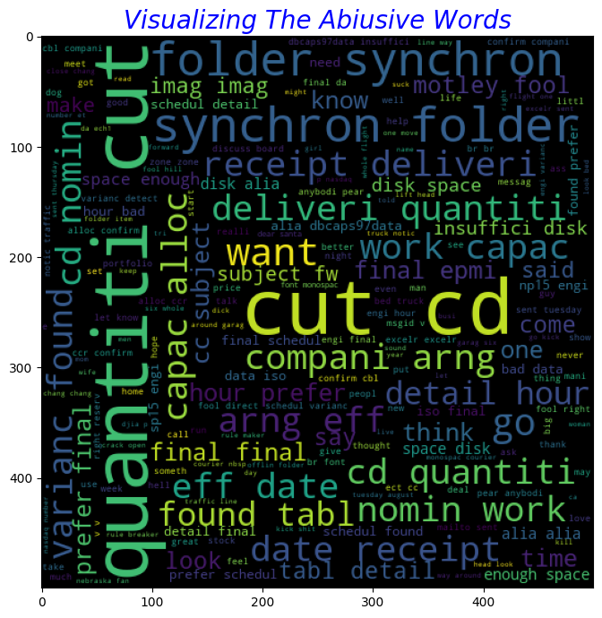
Visualizing Word Cloud for Abusive Mails

Slide 15
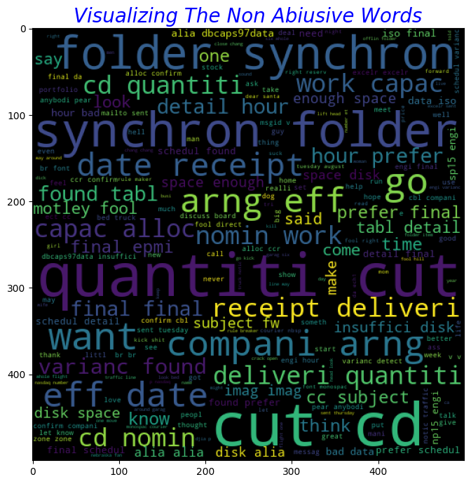
Visualizing Word Cloud for Non Abusive Mails

Slide 16
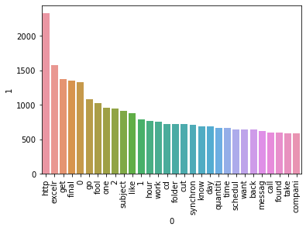
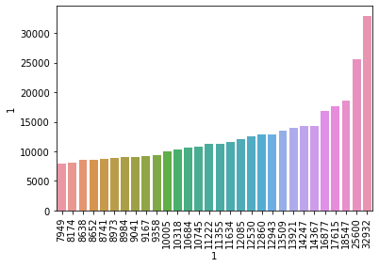
Visualizing most occurred word in Abusive and Non Abusive Email

Slide 17
THANK YOU

